Slide 1
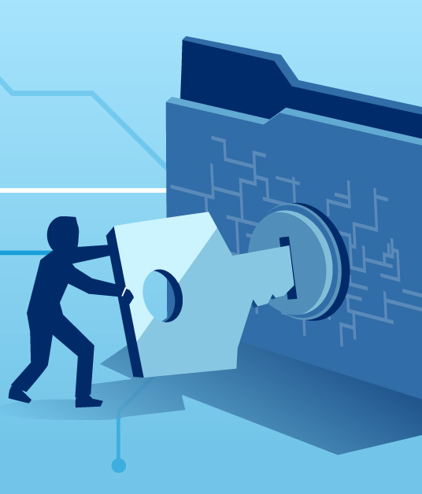
Computer Security

Slide 2

Objectives
At the end of the lesson students should be able to

Slide 3
Starter Activity

Slide 4
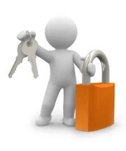
What is Computer Security?
Computer security is the protection of the computer system from any event or action that could cause a loss of or damage to computer hardware, software, data, information or processing capabilities.

Slide 5
Security Measures
Security measures are essential to ensure that data retains its integrity, prevent data loss and to ensure data is available at all times.
There are a number of measures that can be taken to keep the computer secure

Slide 6
Video slide
Watch the video below and make salient point on what you see and hear

Slide 7

Security measures that ensure that data maintains confidentiality, has integrity and is availability are:
Authentication methods
Authorization methods
Backup in case data becomes unavailable

Slide 8
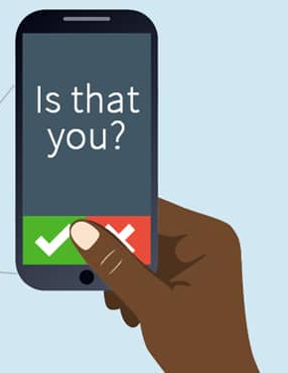
Authentication verifies that the individual is the person he or she claims to be.
It ensures that authorized users have access to the information they need and preventing unauthorized users from gaining access to information they should not have.

Slide 9

The authentication approaches can be classified into three types according to the distinguishing characteristics they use
Biometric-based authentication (something you are) - biometrics, or anything that uniquely identifies the user
Knowledge-based authentication (something you know) - username, password, pin, secret answer to a question
Possession-based authentication (something you have) - swipe card, bank account number, any other physical identifying device

Slide 10

Knowledge base Authentication
Knowledge-based authentication (KBA) is a security measure that identifies users by asking them to answer specific security questions in order to provide accurate authorization for online or digital activities.
These are most common types that are used widely worldwide
username and password — also called a user ID (identification), log on name, or sign in name — is a unique combination of characters, such as letters of the alphabet or numbers, that identifies one specific user.
Passphrase instead of passwords, some organizations use passphrases to authenticate users. A passphrase is a private combination of words, often containing mixed capitalization and punctuation, associated with a username that allows access to certain computer resources
Pin (personal identification number), sometimes called a passcode, is a numeric password. Pins provide an additional level of security.

Slide 11
What is a Password?
It is a unique combination of characters, such as letters of the alphabet or numbers that identifies one specific user

Slide 12
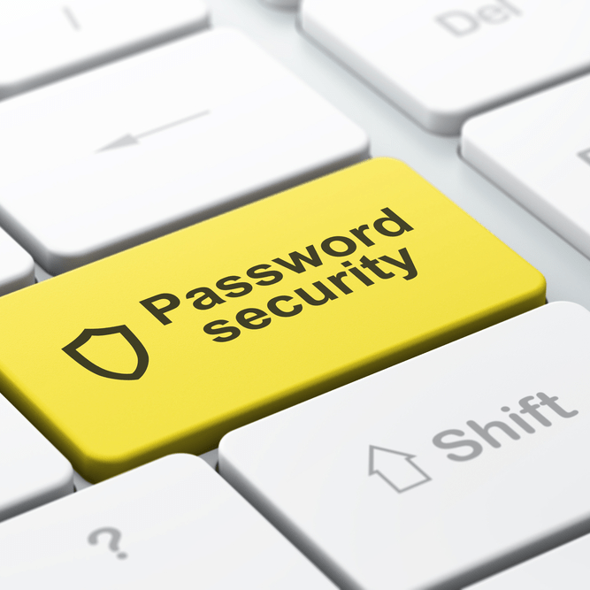
In order to improve password security and protect it from dictionary and brute force attacks, password policy should implement rules for choosing and maintaining passwords.
The major rules are:
Non-dictionary and no-name passwords.
Long enough passwords with mixed types of characters.
Password ageing and not reusing.
Complex passwords using acronyms, rhymes, and mnemonic phrases, which are difficult to guess and easy to remember.
Passwords should not be shared and should not be written down.
The number of unsuccessful authentication attempts should be limited by the system.
Passwords should never be stored in clear text; they should be encrypted or hashed.

Slide 13
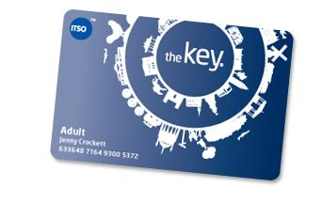
Possession-base Authentication

Slide 14
Possession-base Authentication
Possession-based authentication, referred to also as token-based authentication, is based on what the user has. It makes use mainly of physical objects that a user possesses, like tokens.
The presentation of a valid token does not prove ownership, as it may have been stolen or duplicated by some sophisticated fraudulent means
Examples of possessed objects are badges, cards, smart cards, and keys, bank account numbers.
Possessed objects often are used in combination with personal identification numbers.
A token is a Physical proof that one has for identification
.

Slide 15
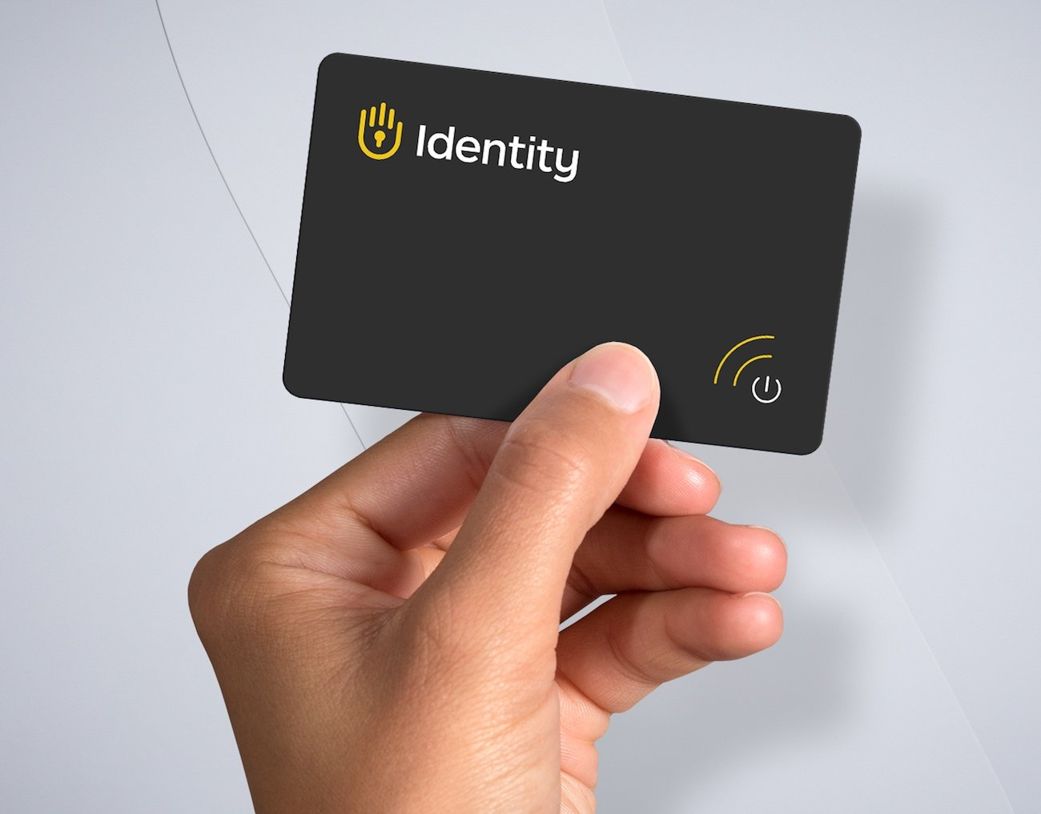
A security token is a physical device that users must possess to access a system.
It can be of two types
Memory Token store information but do not process it. It is used together with a PIN. Magnetic cards is n example. They store information but does not process it. Memory tokens are inexpensive to produce. Using them with PINs provides significantly more security than PINs or passwords alone.
Smart Token enable them to process information. Most smart tokens are used for authentication together with a knowledge-based authentication mechanism such as a PIN. Smart tokens are more expensive than memory tokens but provide greater flexibility and security and are more difficult to forge.

Slide 16
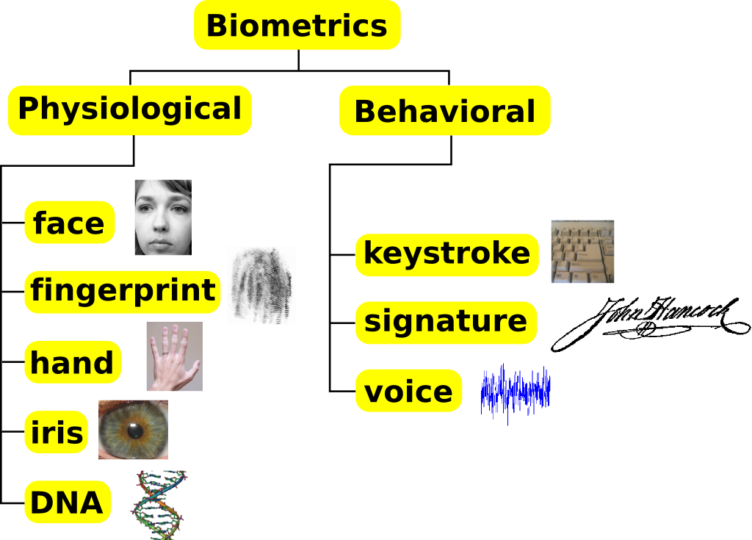
Biometrics
Is the process of using a person’s body parts to identify them.
Physical characteristics are unique; they provide a unique way to identify a user.
Examples of biometric
Fingerprint
face recognition
hand geometry
voice verification
signature verification
iris recognition
retina scanners.

Slide 17
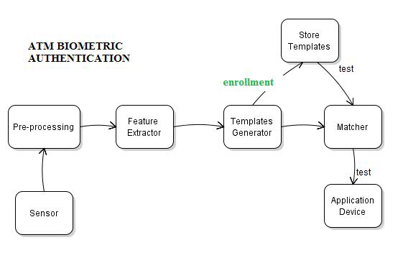
How Biometric works
Biometric devices authenticates persons identify by translating a personal characteristics, such as a fingerprint, into a digital code that is compared with a digital code stored on the computer or mobile device verifying a physical or behavioural characteristic.
If the digital code in the computer or mobile device does not match the personal characteristics code, the computer or mobile device denies access to the individual

Slide 18
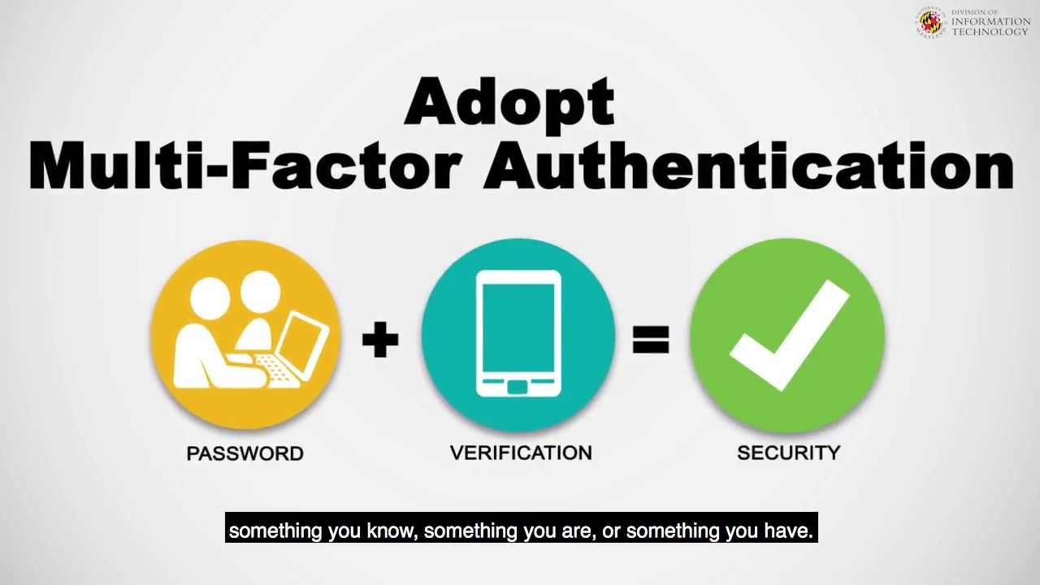
What is Multi-Factor authentication?
MFA is an authentication method that requires the user/ computer/software to produce multiple identifiers to be authenticated.
It employs two or more independent ways to verify users’ identity.

Slide 19
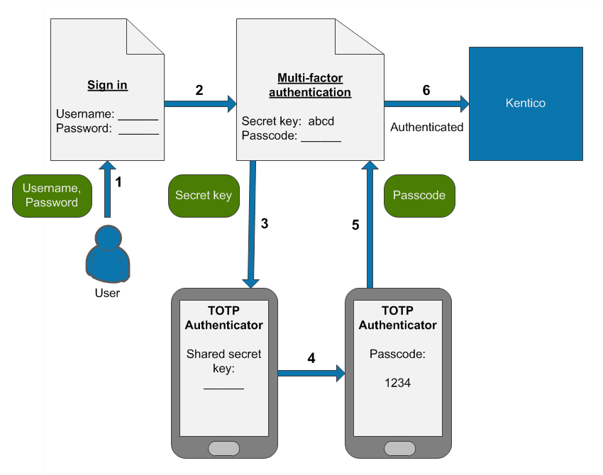
How it works?

Slide 20
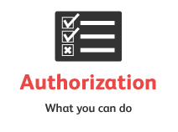
Authorization
Authorization is defined as a process ensuring that correctly authenticated users can access only those resources for which the owner has given them approval. It usually takes place after a person has been both identified and authenticated
It will determine what a person can then do on the system.
Access control is one method that determine the right a person have to access different type of resources on a system

Slide 21
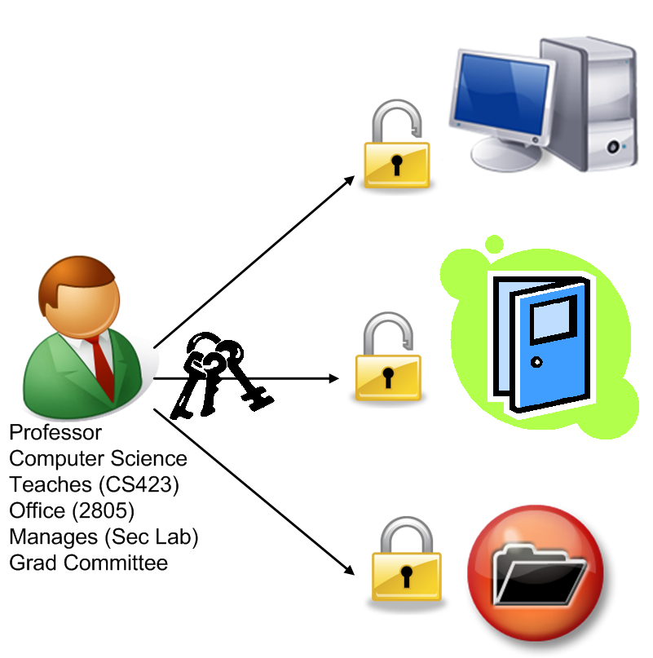
Access control
Access control is a security term used to refer to a set of policies for restricting access to information, tools, and physical locations.
It outlines what permission is needed to access a computer, when access can be done what data can be access and what actions can be taken while accessing the computer.

Slide 22
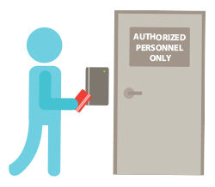
Types of methods/devices that help with access control breaches

Slide 23
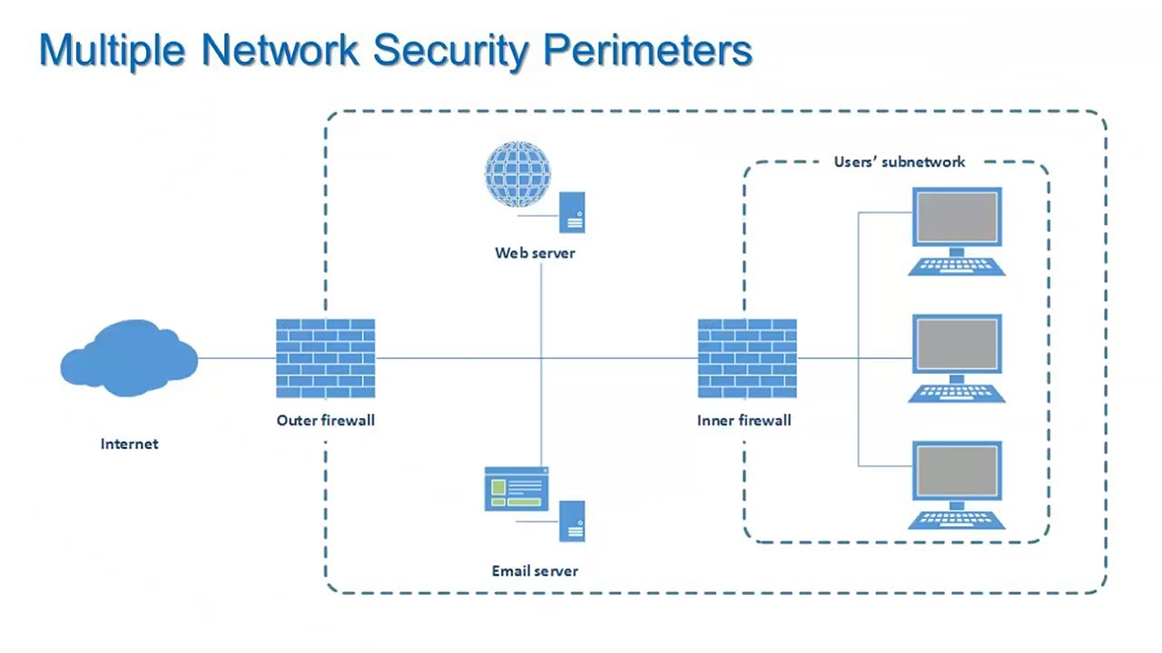
Firewall
A firewall is a software or hardware or a combination of both that filters the information coming in through the Internet connection to your computer system or network.
It protects the computer and its data from unauthorized intrusion from outside.
used to block access from outside.

Slide 24
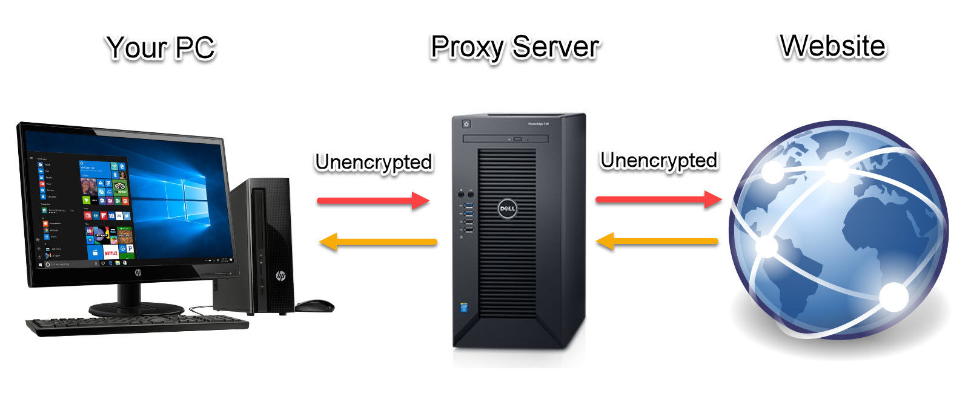
Proxy Servers
It is a hardware/server that acts as a middleman between the user and the web server.
It uses a different IP address to conceal the user’s real address from
It does the following
allows the internet ‘traffic’ to be filtered; they can block access to a website
Store frequently used files into CACHE, which speed up access to information from a website;
keeping the user’s IP address secret – this clearly improves security

Slide 25
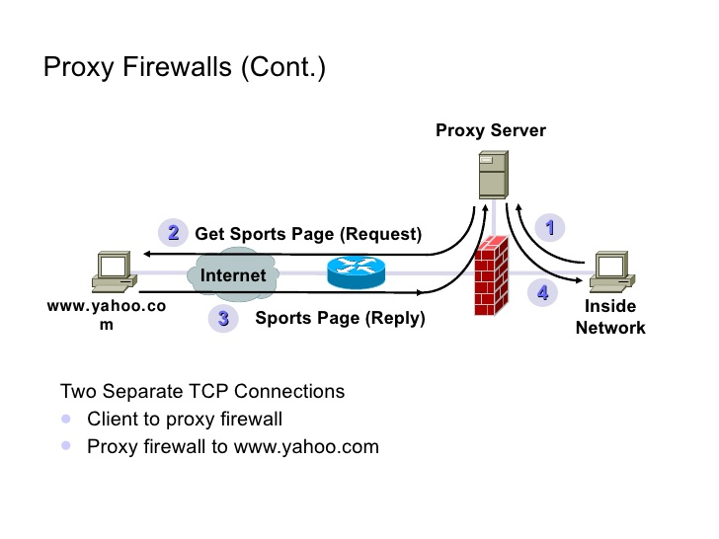
How Proxy Servers Works
A standard proxy server configuration works as follows: A user enters a website's URL into their browser.
The proxy server receives the user's request.
The proxy server forwards the request to the web server.
The web server sends a response (website data) back to the proxy server.
The proxy server forwards the response to the user.

Slide 26
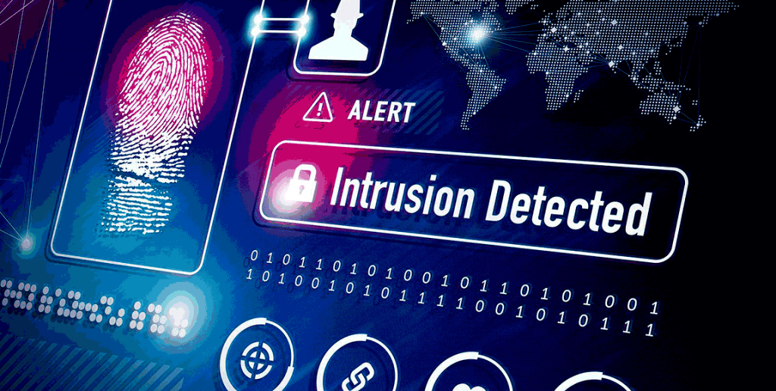
Intrusion Detection Program/System

Slide 27
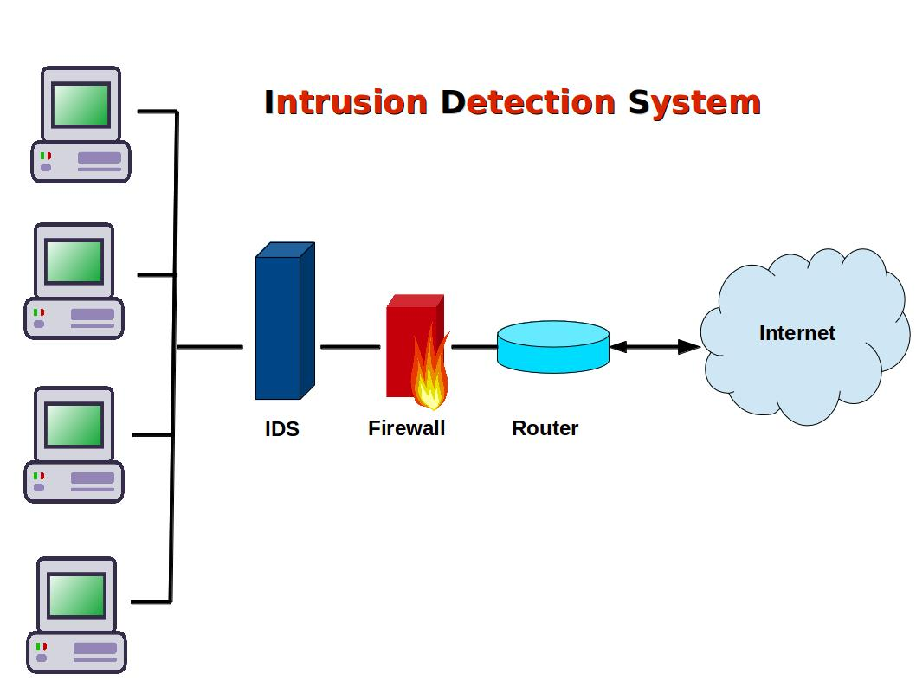
Intrusion Detection Program/System
An intrusion detection system (IDS) is software specifically built to monitor network traffic and discover irregularities.
Unwarranted or unexplained network changes could indicate malicious activity at any stage, whether it be the beginnings of an attack or a full-blown breach.

Slide 28
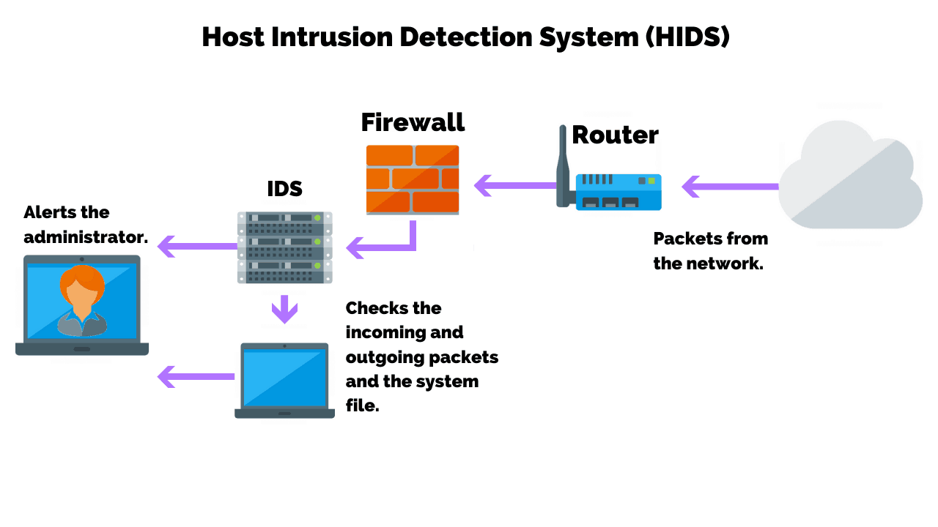
Intrusion Detection Program/System
An Intrusion Detection System (IDS) is a system that monitors network traffic for suspicious activity and issues alerts when such activity is discovered.
It is a software application that scans a network or a system for harmful activity or policy breaching.
Any malicious venture or violation is normally reported either to an administrator or collected centrally using a security information and event management (SIEM) system.

Slide 29

Activity 2
Complete the questions on the given worksheet
Revive your answers with your teacher’s

